Slide 1
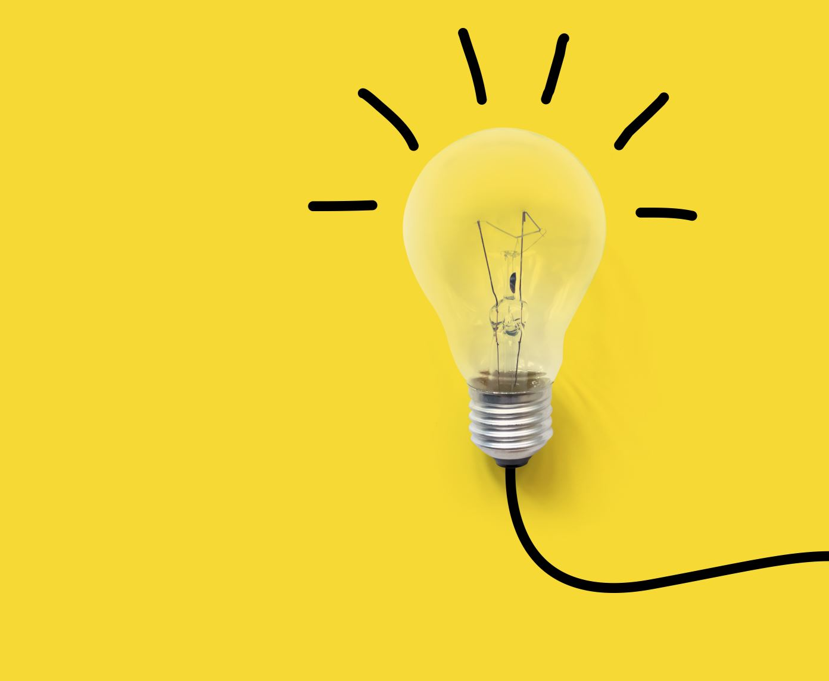
Modeling Innovation Diffusion And Cognition
Paul Albert
5/6/21
CSS635 – Cognitive Foundations of Computational Social Science

Slide 2
Innovation Diffusion defined by adoption accelerators (e.g., peer effects, network effects) and adoption barriers (e.g., path dependencies, cost)
New hybrid corn seed
Mechanized cotton looms in 1700’s France
Electric Cars
Use of personal email
Choice of email provider (”Hotmail” vs “Google”)
Rise of Protestantism
Scientific Paradigms
Language conventions
Fashions/Fads (e.g., artistic practices)

Slide 3
“Herd Effects” (not “Utility Effects”) might better explain adoption acceleration in many cases
"You can see the computer age everywhere but in the productivity statistics.”
- Robert Solow, 1987
While the computing capacity of the U.S. increased a hundredfold in the 1970s and 1980s, labor productivity growth slowed from over 3% in the 1960s to roughly 1% in the 1980s.
- Wikipedia, Productivity Paradox

Slide 4
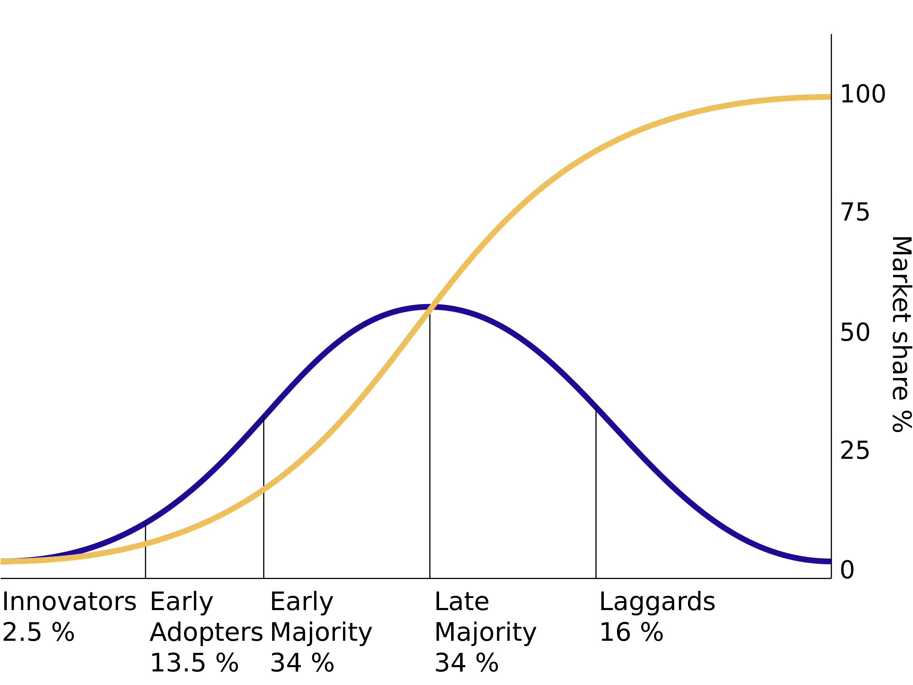
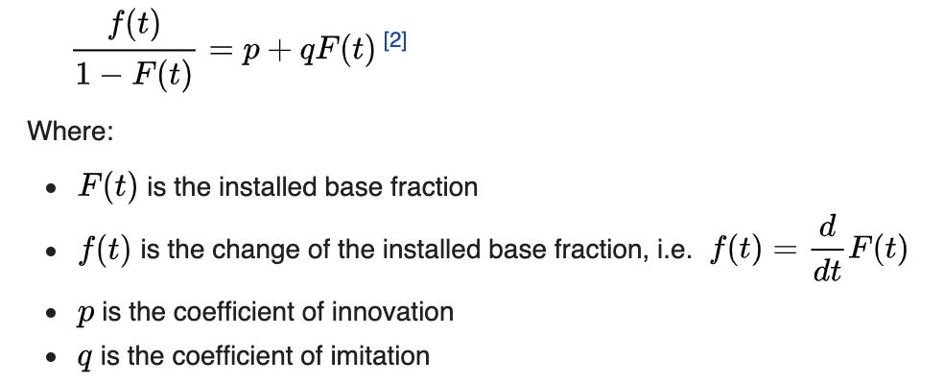
Bass Diffusion Model Bass, Frank (1969). "A new product growth model for consumer durables". Management Science 15 (5): p215–227. (10,129 Citations)
Everett Rogers
“Diffusion of Innovations”
1962 (127,912 Citations)
Sources: Wikipedia, Google Scholar
Notes:
Side note, Bass’s paper actually did not show the traditional ”S” curve,

Slide 5
Determining Adoption in Model
“p” (Innovation Coefficient) Parameters: 0.01, 0.02, 0.03
Allow Heterogeneity: 0, 0.6
Randomly Adopt?
Yes
Tick
No
Agent Adopts
Look at neighbors and adopt?
Yes
“q” (Imitation Coefficient) Parameters: 0.2, 0.4, 0.6
Allow Heterogeneity: 0, 0.6

Slide 6
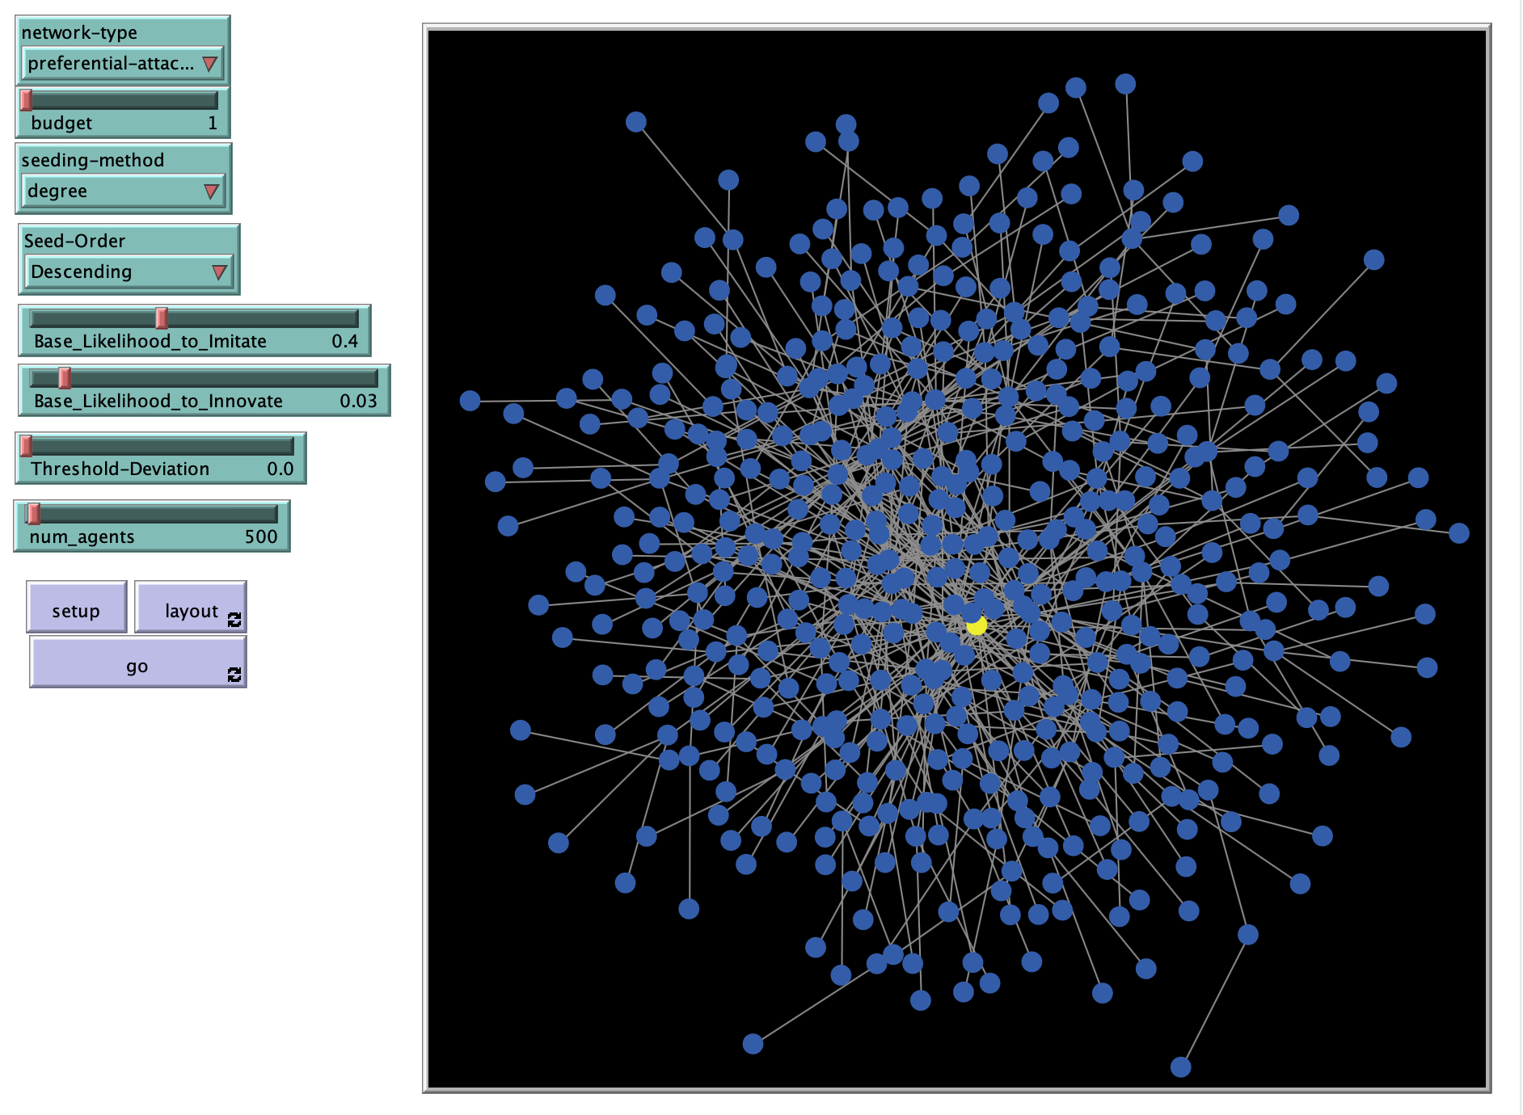
Project NetLogo Model
Based on - Rand, W. & Wilensky, U. (2012). NetLogo Simple Viral Marketing model. http://ccl.northwestern.edu/netlogo/models/SimpleViralMarketing. Center for Connected Learning and Computer-Based Modeling, Northwestern Institute on Complex Systems, Northwestern University, Evanston, IL.

Slide 7
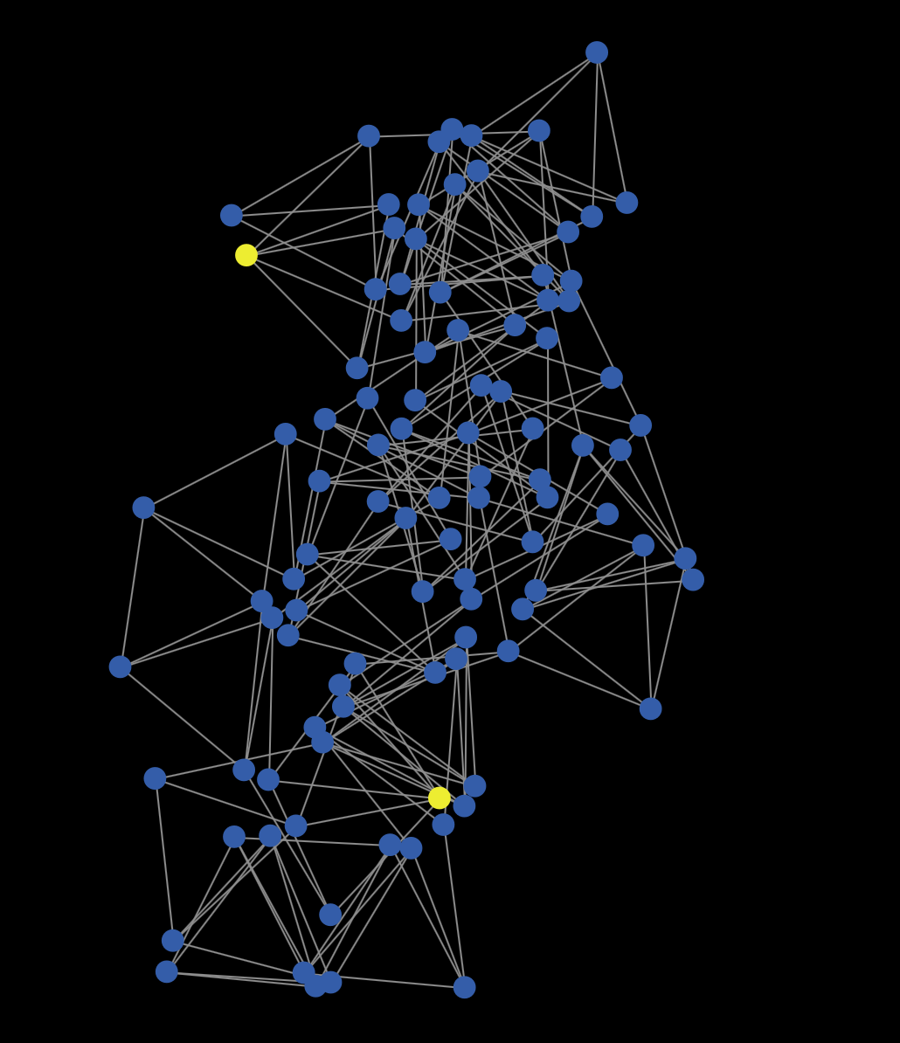
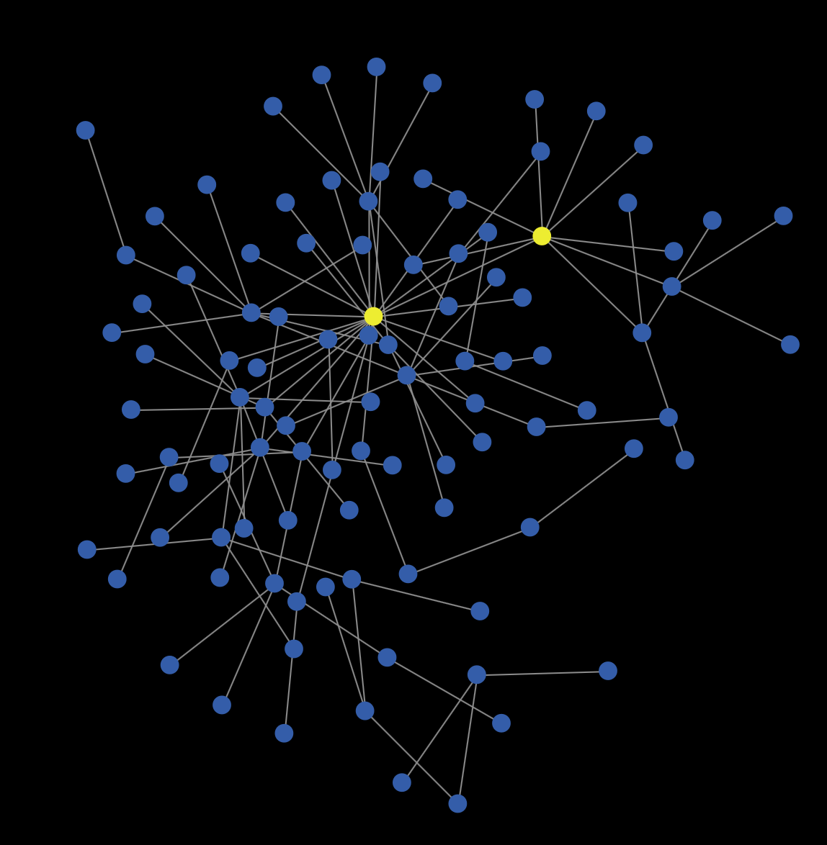
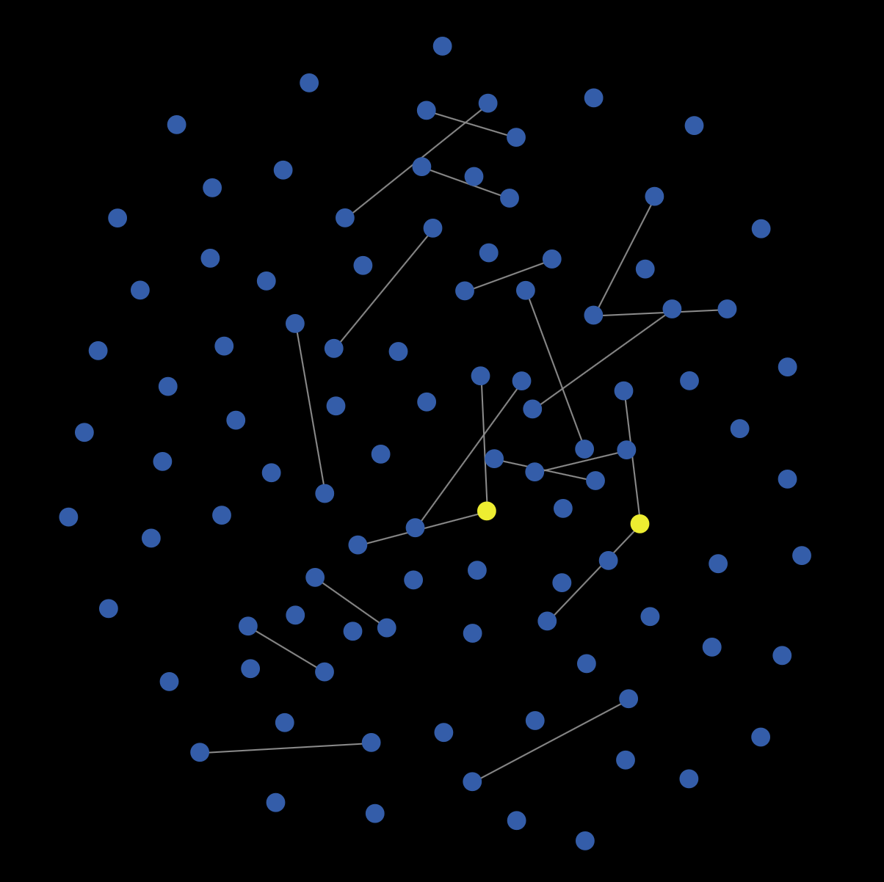
Sample NetLogo Generated Networks Tick 0 (100 Nodes, 2 Initial Seeds)
Small World
Preferential Attachment
Random
Some - Many - Some
Many - Some - Few
Few - Many - Few
Which network type will show the fastest innovation diffusion?
Will diffusion increase or decrease as network size increases?

Slide 8
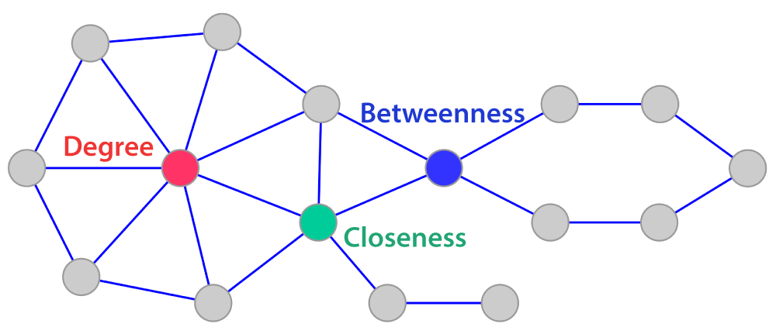
Different measures of “Network Centrality” used in model.
“Descending” seeding order seeds nodes from highest value to lowest, “ascending” does opposite
All else being equal, which centrality measure for seeding would have the greatest impact on diffusion?

Slide 9
Determining Adoption
“p” (Innovation Coefficient) Parameters: 0.01, 0.02, 0.03
Allow Heterogeneity: 0, 0.6
Randomly Adopt?
Yes
Which has a bigger impact on adoption (”p” or “q”)?
Tick
No
Agent Adopts
Look at neighbors and adopt?
Yes
“q” (Imitation Coefficient) Parameters: 0.2, 0.4, 0.6
Allow Heterogeneity: 0, 0.6

Slide 10
Determining Adoption
“p” (Innovation Coefficient) Parameters: 0.01, 0.02, 0.03
Allow Heterogeneity: 0, 0.6
Randomly Adopt?
Yes
How would allowing heterogeneity in “p” and “q” effect adoption rates?
Tick
No
Agent Adopts
Look at neighbors and adopt?
Yes
“q” (Imitation Coefficient) Parameters: 0.2, 0.4, 0.6
Allow Heterogeneity: 0, 0.6

Slide 11
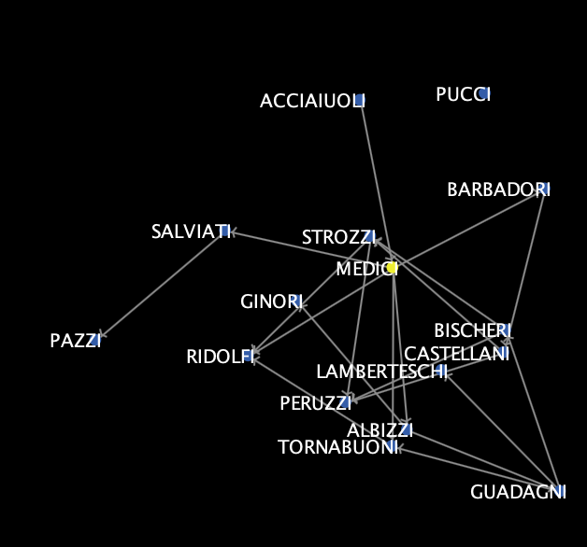
Florentine Elite Marriage Network
1400-1434
(John Padgett, Christopher Ansell)
In one of the most famous network studies, Padgett and Ansell use network analysis to examine the rise of the Medici family to the height of Florentine politics…, where the family came to run the city-state for several generations. … The Medici, through marriage and business ties, thus came to the center of Florentine politics as they connected both the old and new families. … When civil strife occurred due to fiscal troubles in the 1420s, Cosimo, as partriarch of the Medici family, was thus the only one in the position to navigate the interests of the most families. This high betweenness in the network endowed the family patriarchs with the structural position to rise to the forefront of Florentine politics in 1434.
- Omar Lizardo, 4.3 Betweenness Centrality, Social Networks: An Introduction (web draft of to-be-published book)
Source: https://infovis.lucdh.nl/datasets/

Slide 12
But Wait! There’s More….. Testing Innovation Diffusion on Other Network Structures
Francis-Bacon – Network generated through text mining Oxford Dictionary of National Biography (8,741 nodes, 19,518 edges, 0.0005 density)
Collaborations - Arxiv COND-MAT (Condense Matter Physics) author collaboration network (23,133 nodes, 183,831 edges, 0.0004 density)
Enron Email – Internal Enron email collaboration network (36,692 nodes, 91,286 edges, 0.0003 density)

Slide 13
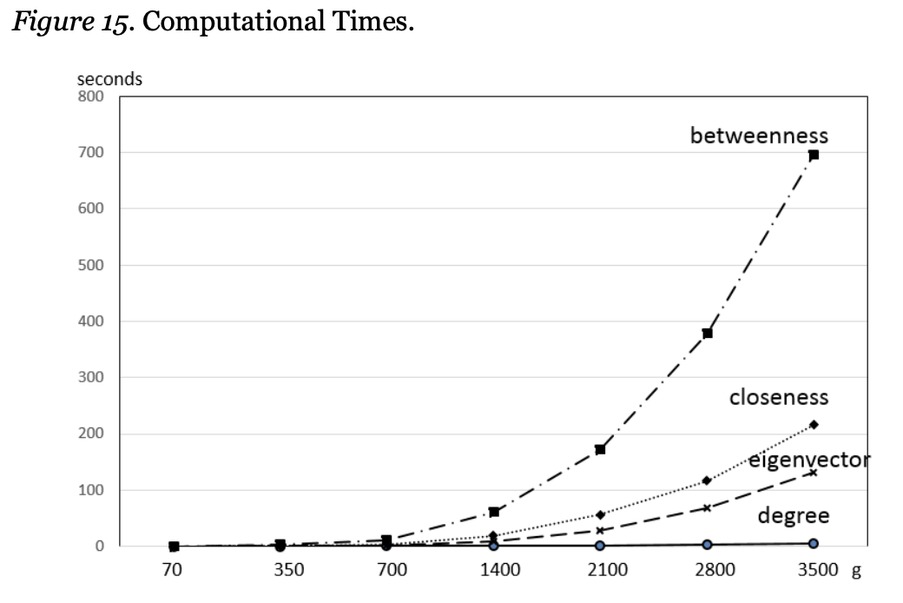
My project “AHA”
In theory, degree centrality might be a bad heuristic to use for identifying a network’s most influential nodes:
“a node having a few high influential neighbors may have much higher influence than a node having a larger number of less influential neighbors.” - Duanbing Chena, Identifying influential nodes in complex networks (2011)
In practice, there is huge overlap between the most central nodes using various centrality measures in both generated and actual networks
Given the much higher effort to determine betweenness and closeness centrality, degree centrality seems a pretty good heuristic for estimating node influence in large networks
Source: In Social Network Analysis, Which Centrality Index Should I Use? (Iacobucci, 2017)

Slide 14
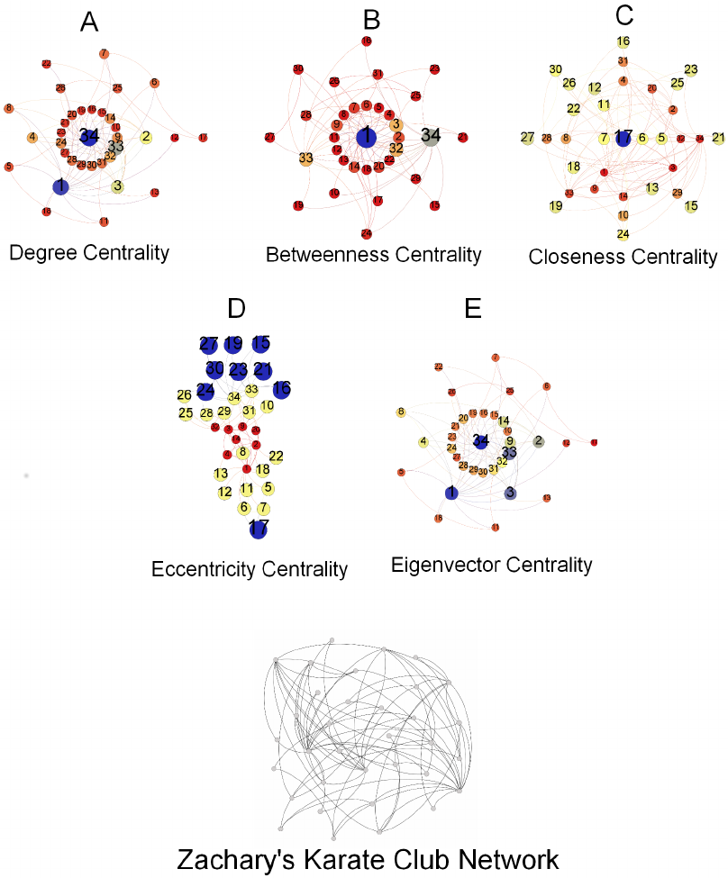

Slide 15
Further (and better) questions to ask
Could there be a parallel between Anscombe’s Quartet and diffusion over different types of networks? Could these networks all have similar measures (density, clustering coefficient, etc.) yet produce different results?

Slide 16
Modeling Innovation Diffusion And Cognition
Paul Albert
5/6/21
CSS635 – Cognitive Foundations of Computational Social Science
For best results, maximize the view using the icon below
GitHub Repository:

